Slide 1
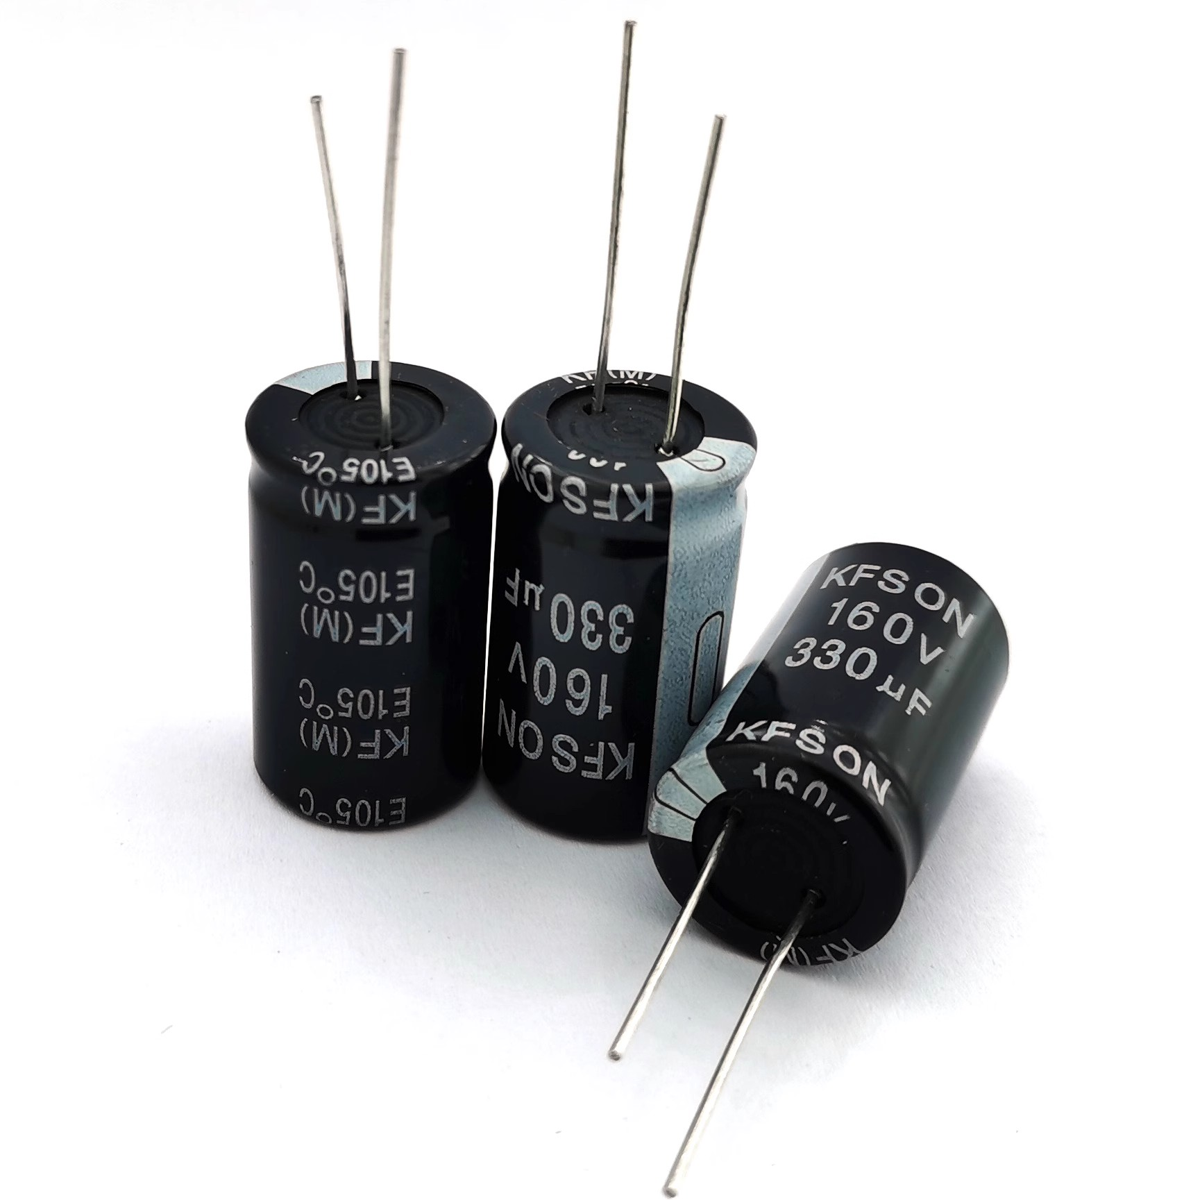
CAPACITANCE
How much charge
can one volt hold?
A lesson on capacitors, charge separation, and the meaning of C = Q/U
STORE • MEASURE • DESIGN
CAPACITANCE • PHYSICS LESSON
01
Notes:
Opening prompt: Where have students seen capacitors? Ask why a camera flash can release energy much faster than a battery.

Slide 2
LESSON MAP
Build the idea in four moves.
01
02
03
04
SEPARATE
MEASURE
DESIGN
APPLY
How two conductors store equal and opposite charge
Why capacitance means charge stored per volt
How area, spacing, and dielectric change C
How to use units, ratings, and C = Q/U
What does a capacitor's capacitance tell us?
Essential question
CAPACITANCE • PHYSICS LESSON
02
Notes:
Preview the learning route. Tell students the equation will make sense only after they understand charge separation.

Slide 3
CHARGE STORAGE
A capacitor stores charge by separating it.
insulating gap
No net charge is created.
+
−
+Q
−Q
Electrons are moved from one conductor to the other. The plates carry equal-magnitude, opposite charges.
+
−
+
−
+
−
+
−
A capacitor needs two conductors separated by an insulator.
conductor A
conductor B
CAPACITANCE • PHYSICS LESSON
03
Notes:
Stress conservation of charge. The capacitor stores separated charge and an electric field between conductors.

Slide 4
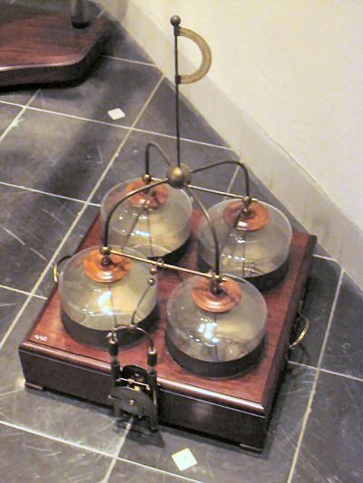
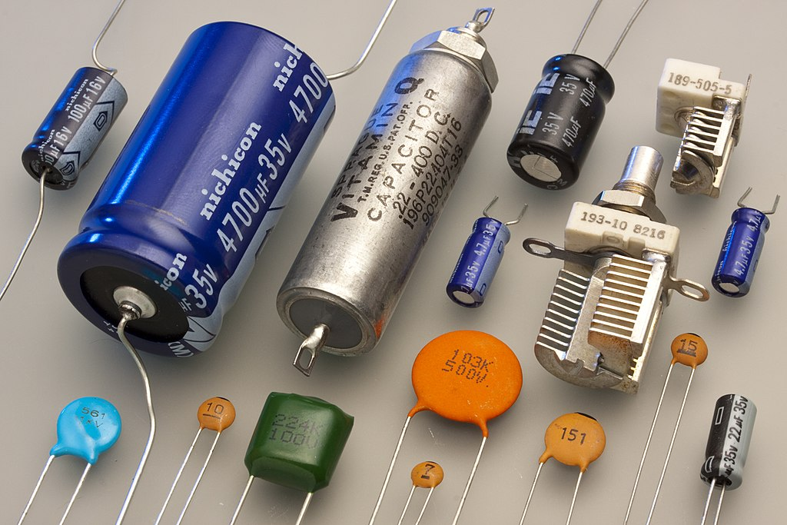
SAME PRINCIPLE
From Leyden jars to modern components, the structure is unchanged.
EARLY CHARGE STORAGE
MODERN CAPACITORS
conductors + insulator
CAPACITANCE • PHYSICS LESSON
04
Notes:
Use the historical image briefly: design and packaging changed, but every capacitor still contains two conductors separated by a dielectric.

Slide 5
CHARGING PROCESS
A battery moves electrons until the capacitor voltage matches the supply.
UNCHARGED
CHARGING
FULLY CHARGED
+
−
+
−
+
−
+
−
+
−
+
−
+
−
+
−
U = 0
0 < U < V
U = V
No charge separation
Electrons are moving
Current falls to zero
More separation → larger potential difference
CAPACITANCE • PHYSICS LESSON
05
Notes:
Clarify that 'fully charged' means the capacitor voltage equals the supply voltage, not that the capacitor has reached its maximum possible charge.

Slide 6
DEFINITION
Capacitance is charge stored per volt.
Same voltage
C = Q / U
+
−
+
−
+
−
+
−
+
−
Q = magnitude of charge on either plate
U = potential difference between the plates
+
−
+
−
+
−
+
−
smaller Q
larger Q
Higher capacitance
CAPACITANCE • PHYSICS LESSON
06
Notes:
Interpret the definition before calculating: at the same voltage, the capacitor holding more separated charge has the larger capacitance.

Slide 7
Q–U RELATIONSHIP
For one capacitor, Q ∝ U—and the slope is C.
Q (C)
Changing Q and U moves the operating point along the same line.
slope = ΔQ / ΔU = C
The line's slope stays fixed because C is a property of the capacitor.
Key distinction
U (V)
C does not increase just because Q increases.
CAPACITANCE • PHYSICS LESSON
07
Notes:
Ask students what a steeper Q-U line means. Emphasize that C is the slope and does not depend on which point is selected.

Slide 8
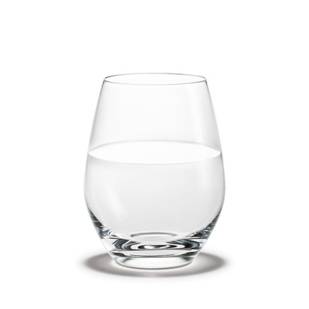

ANALOGY
Water storage is useful—until the analogy starts to mislead.
Use the analogy for comparison:
At the same “pressure,” a larger-capacitance device holds more charge.
But remember:
Voltage is potential difference, not literal fill height. Charge is separated across two conductors.
amount of water ↔ separated charge Q
container capacity ↔ capacitance C
CAPACITANCE • PHYSICS LESSON
08
Notes:
Use the original water analogy, then explicitly identify its limitation so students do not imagine charge filling a single container.

Slide 9
PHYSICAL DESIGN
Geometry and dielectric set capacitance.
Parallel plates
C = εA / d
+
−
+
−
A
plate overlap area
+
−
larger A → larger C
d
+
−
d
plate separation
smaller d → larger C
+
−
ε
dielectric response
larger ε → larger C
overlap area A
CAPACITANCE • PHYSICS LESSON
09
Notes:
Introduce the parallel-plate result as a structural model. The definition C = Q/U tells what capacitance means; C = εA/d tells what determines it.

Slide 10
CONTROLLED COMPARISONS
Three design changes make capacitance larger.
MORE AREA
SMALLER GAP
DIELECTRIC
+
−
+
−
+
−
+
−
+
−
+
−
d
ε ↑
+
−
+
−
+
−
+
−
+
−
+
−
+
A ↑
−
+
−
+
−
more charge can face across the gap
opposite charges interact more strongly
polarization reduces the voltage per Q
All three changes increase C.
CAPACITANCE • PHYSICS LESSON
10
Notes:
Treat each panel as a controlled comparison: change one structural variable while keeping the others fixed.

Slide 11
UNITS & SCALE
One farad is large, so most components use sub-units.
F
farad
1 F
mF
millifarad
10⁻³ F
µF
microfarad
10⁻⁶ F
nF
nanofarad
10⁻⁹ F
pF
picofarad
10⁻¹² F
1 F = 1 C/V
CAPACITANCE • PHYSICS LESSON
11
Notes:
Practice reading component labels. Point out that a typical electrolytic capacitor may be in microfarads, while timing and radio circuits may use nanofarads or picofarads.

Slide 12
VOLTAGE LIMITS
Capacitance is useful only below the voltage limit.
normal operation
Stay at or below the rated voltage.
Beyond breakdown, the dielectric conducts.
0 V
rated voltage
breakdown
breakdown voltage > rated voltage
CAPACITANCE • PHYSICS LESSON
12
Notes:
Explain that the rated voltage includes a safety margin. A capacitor's printed voltage is not its operating voltage; it is the maximum recommended limit.

Slide 13
WORKED EXAMPLE
Use C = Q/U by choosing the unknown first.
A 220 µF capacitor is connected to 12 V. What charge magnitude is stored on either plate?
1
Rearrange
Q = CU
ANSWER
2
Convert
2.64 mC
220 µF = 220 × 10⁻⁶ F
on each plate
(equal magnitude,
opposite sign)
3
Calculate
Q = (220 × 10⁻⁶)(12) = 2.64 × 10⁻³ C
CAPACITANCE • PHYSICS LESSON
13
Notes:
Ask students to estimate the order of magnitude before calculating. Check that microfarads are converted to farads.

Slide 14
EXIT TICKET
A complete mental model answers three questions.
1
WHAT IS STORED?
Equal-magnitude, opposite charges separated across two conductors.
2
WHAT DOES C MEAN?
Charge stored per volt: C = Q/U. For one capacitor, C is constant.
3
WHAT SETS C?
Geometry and dielectric: larger A, smaller d, larger ε.
Final check: Why does doubling Q not automatically double C?
CAPACITANCE • PHYSICS LESSON
14
Notes:
Use the final check as an exit ticket. Expected answer: for the same capacitor, doubling Q also doubles U, so Q/U remains constant.

